Slide 1
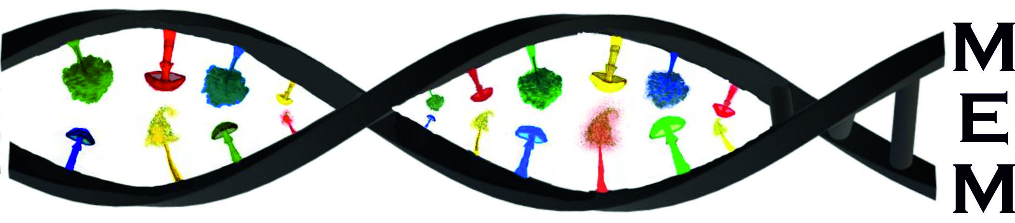
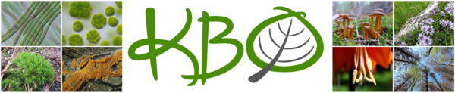
Aktuálne problémy v biológii 2
laboratórium
Molekulárnej
Ekológie a
Mykológie
Autotrofné a heterotrofné organizmy
– zhody, nezhody alebo náhody?
Slavomír Adamčík

Slide 2


Aktuálne problémy v biológii 2
Autotrofné a heterotrofné organizmy
– zhody, nezhody alebo náhody?
Microbial ecology
Six Key Topics in Microbiology
Antimicrobial Resistance
Environmental Microbiology
Pathogenicity and Virulence
Biotechnology and Synthetic Biology
Microbiomes
Food Microbiology
Microbial ecology provides insights into the ecological and evolutionary dynamics of microbial communities underpinning
every ecosystem on Earth.

Slide 3
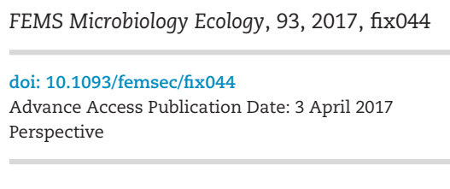

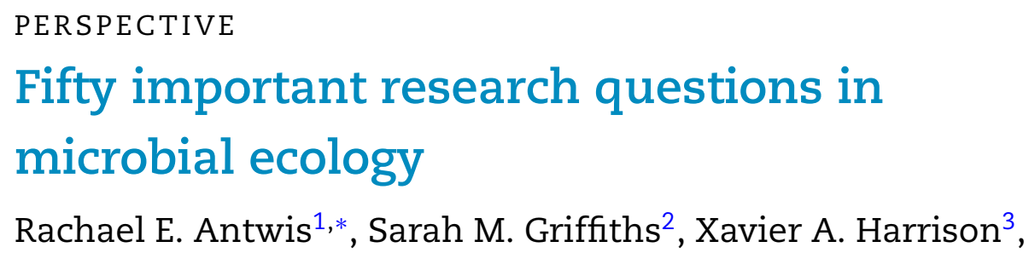
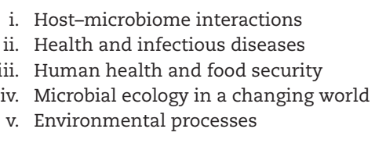

Aktuálne problémy v biológii 2
Autotrofné a heterotrofné organizmy
– zhody, nezhody alebo náhody?
Six Key Topics in Microbiology
Antimicrobial Resistance
Environmental Microbiology
Pathogenicity and Virulence
Biotechnology and Synthetic Biology
Microbiomes
Food Microbiology

Slide 4
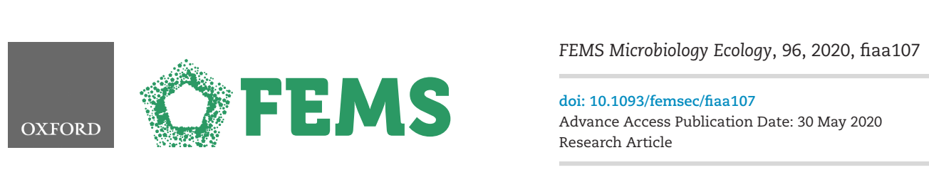
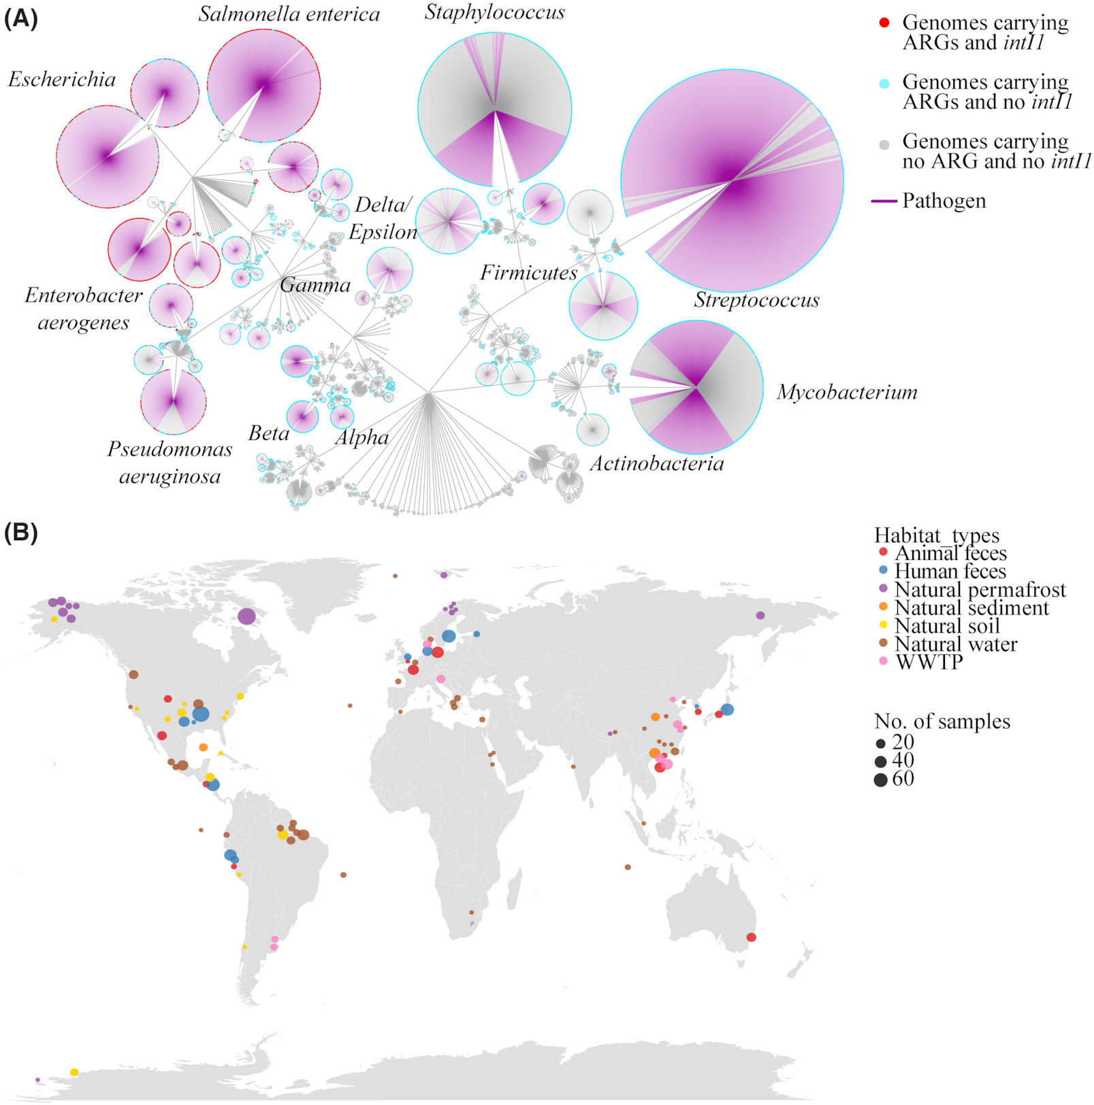
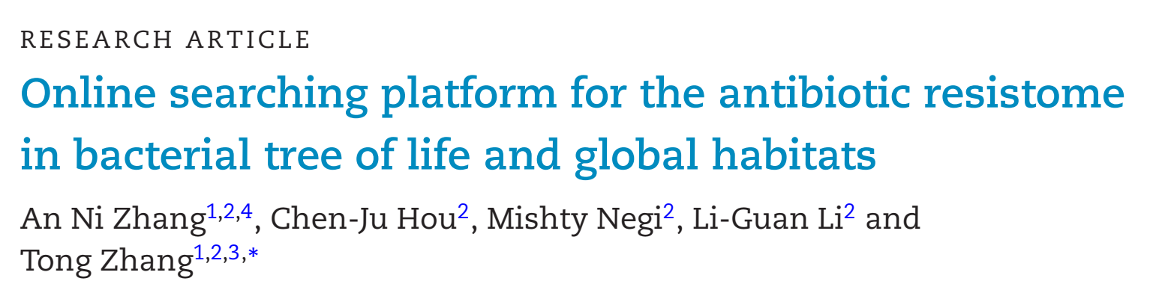
Aktuálne problémy v biológii 2
antibiotic-resistance genes (ARGs) are widely distributed in both human-associated and non-human-associated habitats.
Six Key Topics in Microbiology
Antimicrobial Resistance
Environmental Microbiology
Pathogenicity and Virulence
Biotechnology and Synthetic Biology
Microbiomes
Food Microbiology

Slide 5
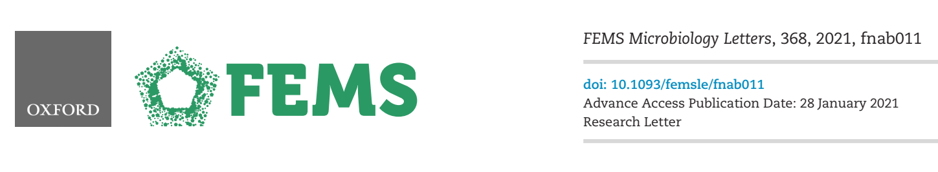
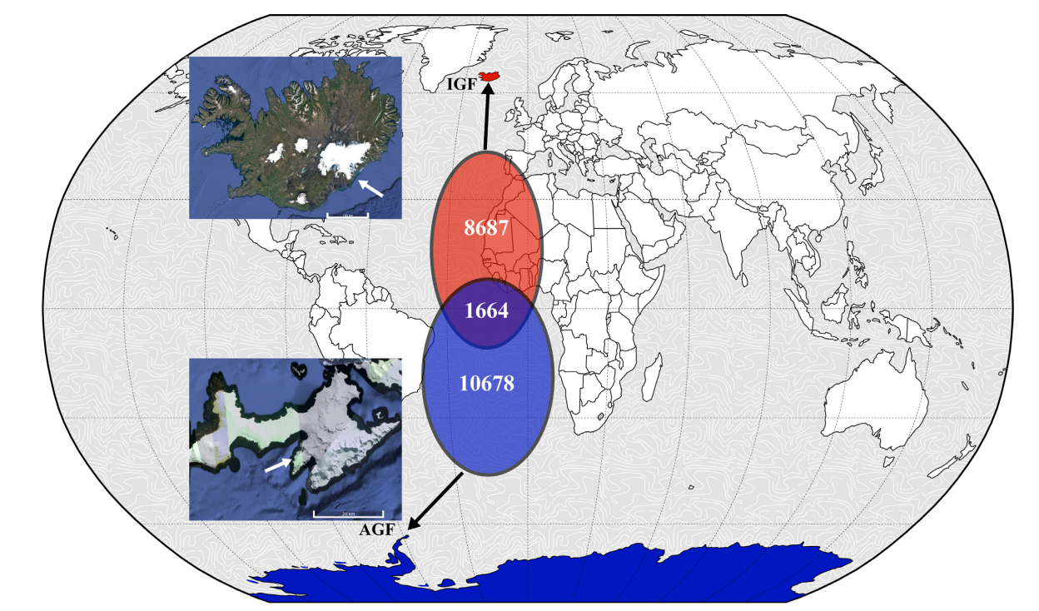
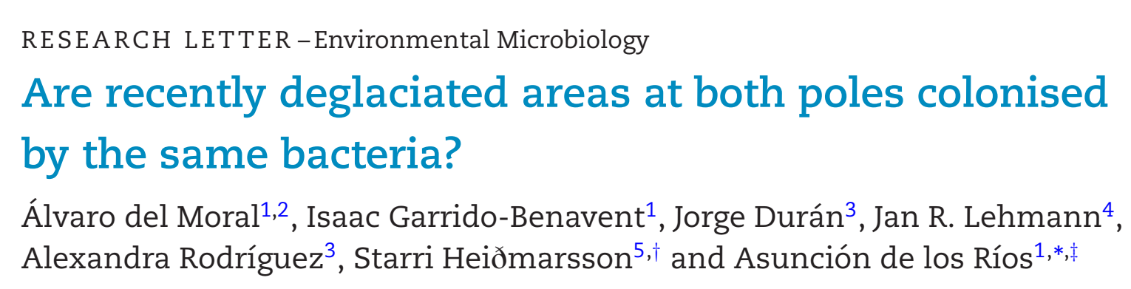
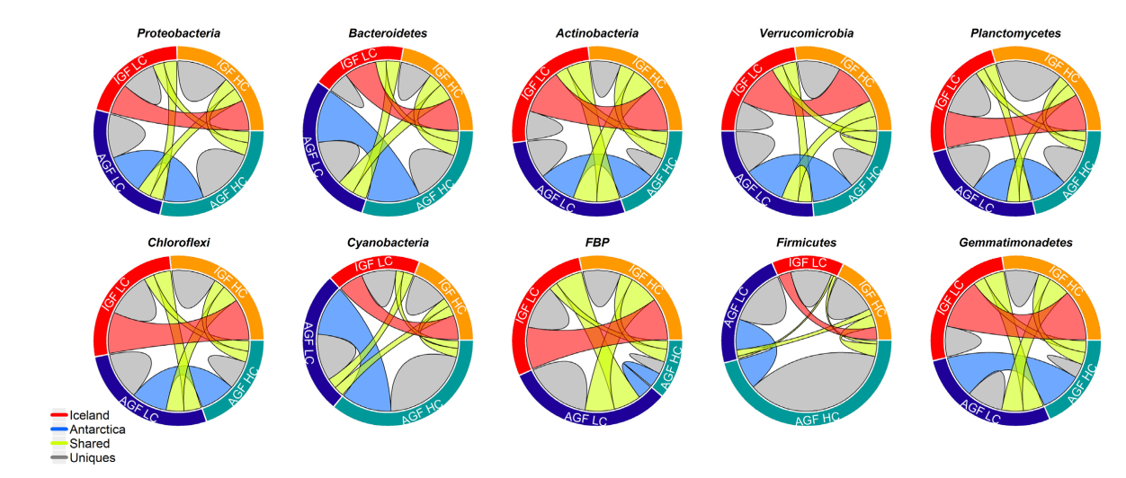
Aktuálne problémy v biológii 2
Through amplicon sequence variant (ASV) inference, the composition and structure of soil bacterial communities from glacier forefields in Iceland and Antarctica was compared
Six Key Topics in Microbiology
Antimicrobial Resistance
Environmental Microbiology
Pathogenicity and Virulence
Biotechnology and Synthetic Biology
Microbiomes
Food Microbiology
only 8% of ASVs share with heterogeneous contribution of each taxonomic group to the shared ASV

Slide 6

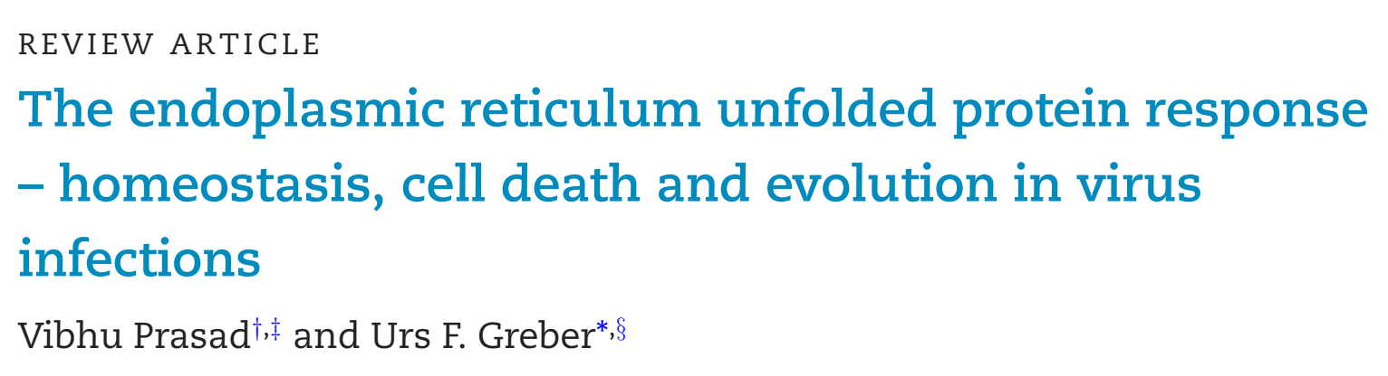
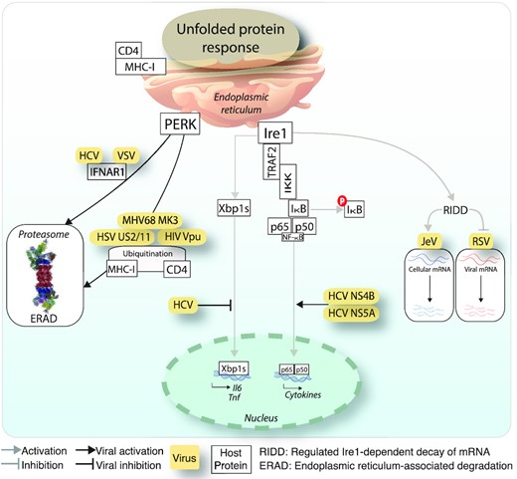
Aktuálne problémy v biológii 2
This review shows how both enveloped and non-enveloped viruses use the unfolded protein response to control cell stress and metabolic pathways, and thereby enhance infection and progeny formation, or undergo cell death
Six Key Topics in Microbiology
Antimicrobial Resistance
Environmental Microbiology
Pathogenicity and Virulence
Biotechnology and Synthetic Biology
Microbiomes
Food Microbiology

Slide 7

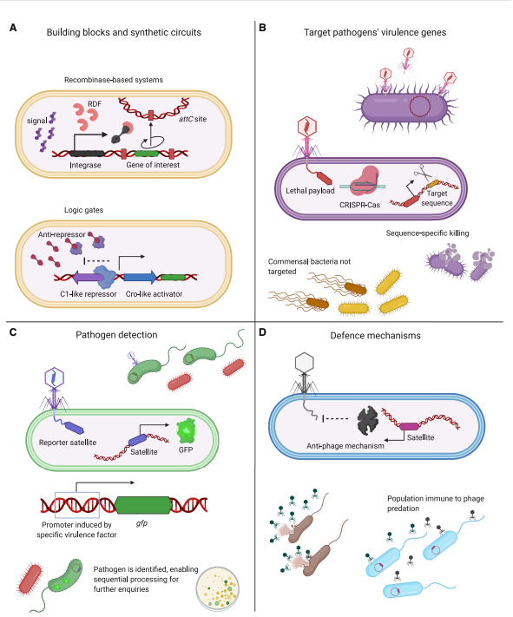
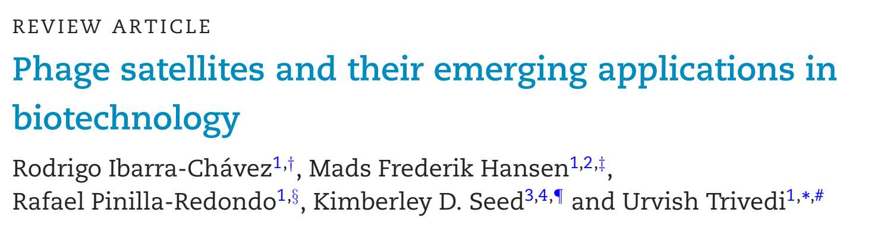
Aktuálne problémy v biológii 2
hyperparasitic mobile genetic elements, so-called phage satellites, exploit (bacterial)phages to ensure their own propagation and horizontal transfer into new bacterial hosts
Six Key Topics in Microbiology
Antimicrobial Resistance
Environmental Microbiology
Pathogenicity and Virulence
Biotechnology and Synthetic Biology
Microbiomes
Food Microbiology
It is discused how these elements can be repurposed for diverse biotech applications

Slide 8
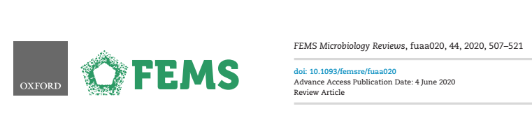
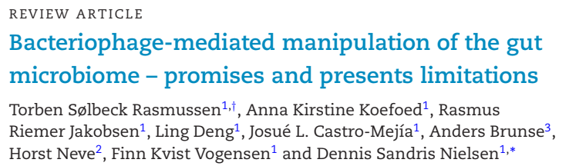
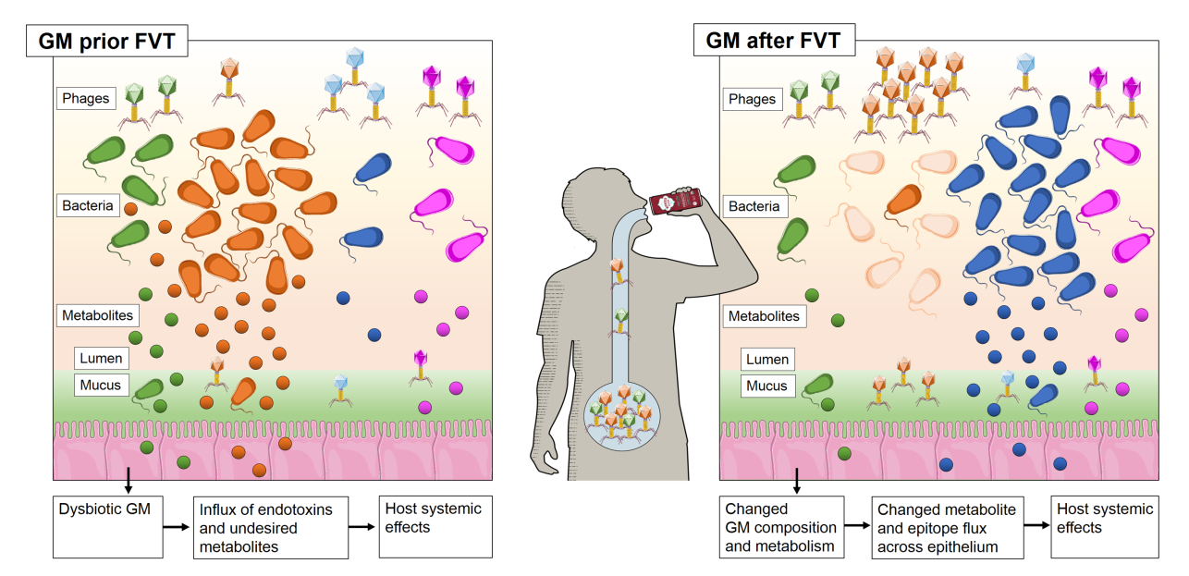
Aktuálne problémy v biológii 2
cascading effects are initiated when phage communities are transferred to the gut by fecal microbiota transplantation, which leads to changes in the gut microbiome composition, host metabolome, and improve host health such as alleviating symptoms of obesity and type-2-diabetes
Six Key Topics in Microbiology
Antimicrobial Resistance
Environmental Microbiology
Pathogenicity and Virulence
Biotechnology and Synthetic Biology
Microbiomes
Food Microbiology

Slide 9
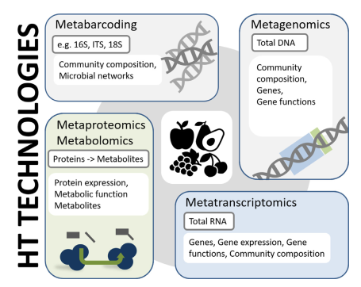

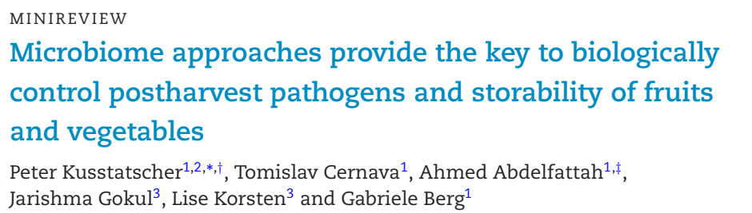
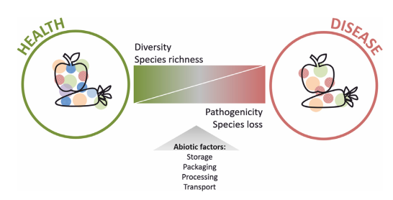
Aktuálne problémy v biológii 2
Fruits and vegetables are holobionts, at harvest, all fruits and vegetables harbor a highly abundant and specific microbiota including beneficial, pathogenic and spoilage microorganisms
Six Key Topics in Microbiology
Antimicrobial Resistance
Environmental Microbiology
Pathogenicity and Virulence
Biotechnology and Synthetic Biology
Microbiomes
Food Microbiology
Field and postharvest handling of fruits and vegetables was shown to affect the indigenous microbiome and storability of fruits and vegetables

Slide 10
Aktuálne problémy v biológii 2
Autotrofné a heterotrofné organizmy – zhody, nezhody alebo náhody?
i. Host–microbiome interactions
ii. Health and infectious diseases
iii. Human health and food security
iv. Microbial ecology in a changing world
v. Environmental processes
vi. Functional diversity
vii. Evolutionary processes
A 1-day workshop was held by the British Ecological Society’s Microbial Ecology Special Interest Group at the University of Salford (UK) in June 2016. Invitations to attend the meeting were distributed via the British Ecological Society’s membership mailing list and through social media (Twitter and Facebook). In total, 34 participants from 20 institutions attended and contributed to the development of the 50 questions listed below, with the majority listed as authors on this paper.

Slide 11
Aktuálne problémy v biológii 2
Autotrofné a heterotrofné organizmy – zhody, nezhody alebo náhody?
1.
A total of 244 questions were submitted by attendees and assigned to the following themes:
2.
Prior to the workshop, participants were asked to identify the top ∼20% of questions in each theme (selection of 5–11 questions from a total of 26–57 questions per theme)
i. Host–microbiome interactions
ii. Health and infectious diseases
iii. Human health and food security
iv. Microbial ecology in a changing world
v. Environmental processes
vi. Functional diversity
vii. Evolutionary processes
For each theme, a final set of ‘gold’ (∼15% of questions, total of 47 questions across all themes) and ‘silver’ questions (∼10% of questions, total of 29 questions) were identified)
3.
For gold questions, duplicates among categories were removed resulting in 43 gold questions. Seven silver questions were elevated to gold status to form the final set of 50 questions
4.

Slide 12
Autotrofné a heterotrofné organizmy – zhody, nezhody alebo náhody?
i. Host–microbiome interactions
What are the primary mechanisms within a host that mediate microbe–microbe and host–microbe interactions?
What are the relative contributions of host-associated and environmental factors in determining host microbial community composition?
How do microbial communities function to affect the phenotype of the host?
Can compositional or evolutionary changes in microbiomes help hosts adapt to environmental change within the lifetime of the host?
What is the role of the microbiota in host speciation processes?
How can the associated microbiota be effectively included in risk assessments of invasive non-native species?
How does the microbiome of captive animals affect the success of reintroduction programmes?
How can a ‘systems biology’ approach improve our understanding of host–microbe interactions?

Slide 13
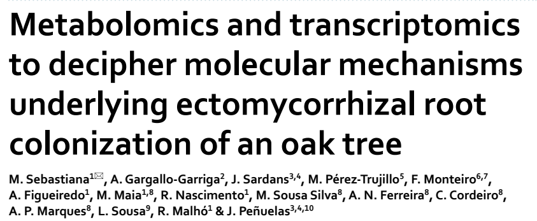
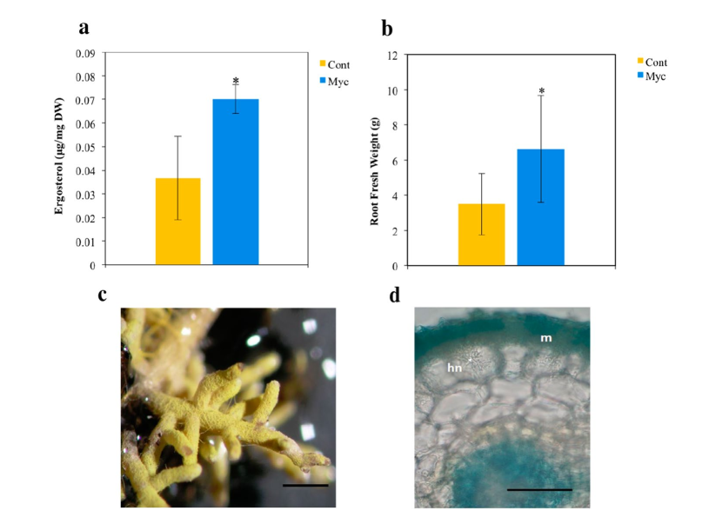
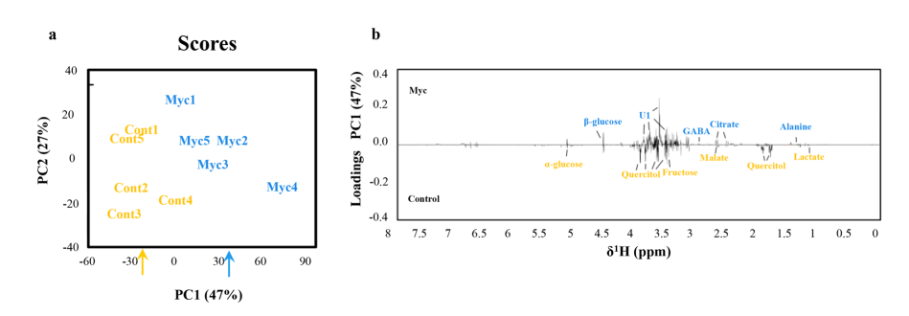
Autotrofné a heterotrofné organizmy – zhody, nezhody alebo náhody?
i. Host–microbiome interactions
What are the primary mechanisms within a host that mediate microbe–microbe and host–microbe interactions?
using metabolomics and transcriptomics approaches, cork oak roots colonized by the ectomycorrhizal fungus Pisolithus tinctorius were compared with non‑colonized roots
non‑proteogenic amino acids, such as gamma‑aminobutyric acid (GABA), and several putative defense‑related compounds, including oxylipin‑family compounds, terpenoids and B6 vitamers were induced in mycorrhizal roots

Slide 14

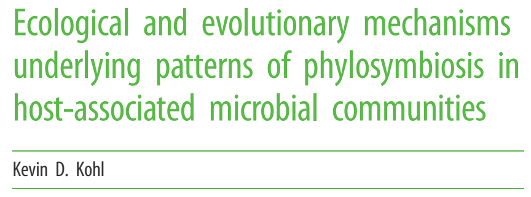
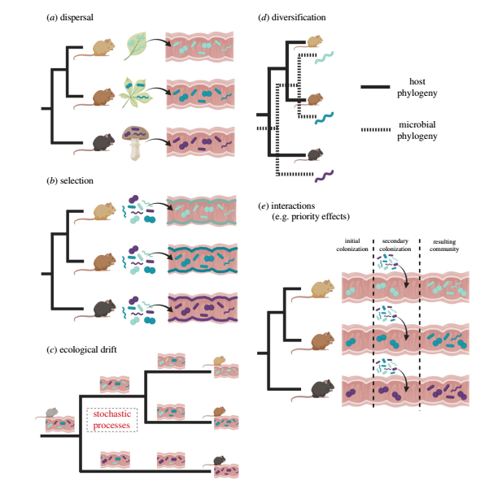


Autotrofné a heterotrofné organizmy – zhody, nezhody alebo náhody?
i. Host–microbiome interactions
2. What are the relative contributions of host-associated and environmental factors in determining host microbial community composition?
Phylosymbiosis: similarities in host-associated microbial communities recapitulate the phylogeny of their hosts
Disperal—host species may come into contact with distinct microbial communities as part of their natural history or transmission from conspecifics.
Selection—hosts may exert selective forces that allow certain microbial members to colonize, while others are excluded from associating with the host.
Ecological drift—stochastic processes may result in the gain or loss of microbial members over evolutionary time.
Diversification—microbes may co-speciate with their host species.
Interactions—here, priority effects are depicted.

Slide 15

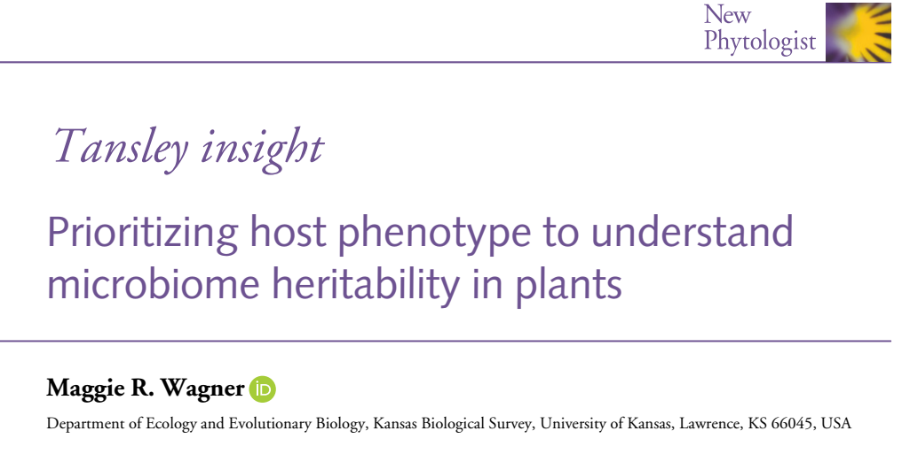
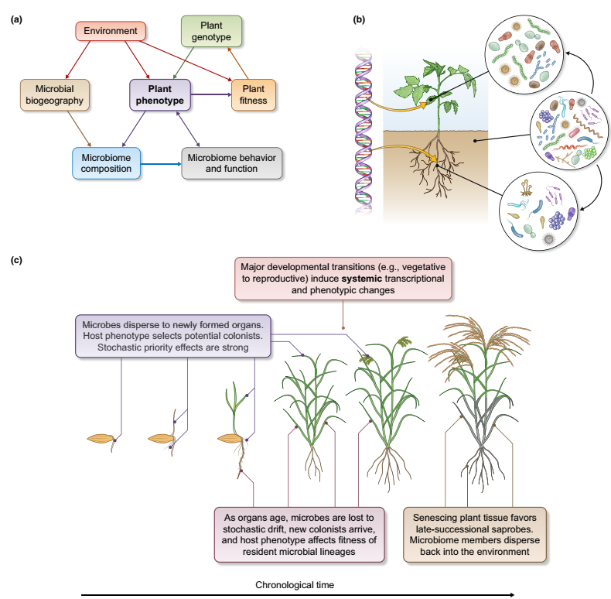
Autotrofné a heterotrofné organizmy – zhody, nezhody alebo náhody?
i. Host–microbiome interactions
3. How do microbial communities function to affect the phenotype of the host?
(a) Microbiome variation arises from complex interactions between host genes and the environment, and can feed back to influence plant fitness. Plant phenotype is a more proximate driver of microbiome composition than plant genotype is,
and in turn, can provide a readout of microbiome behavior and function
(b) A single host genome gives rise to strongly differentiated organs and tissues, which differentially filter the environmental microbial community to form distinct organ-specific microbiomes.
(c) Microbiome succession across host anatomy and development involves both stochastic and deterministic processes.

Slide 16
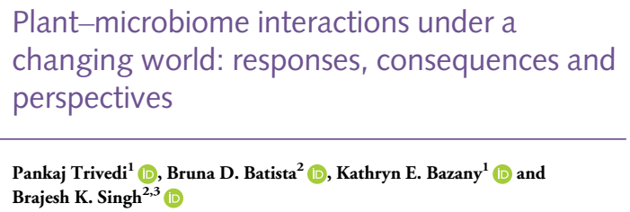
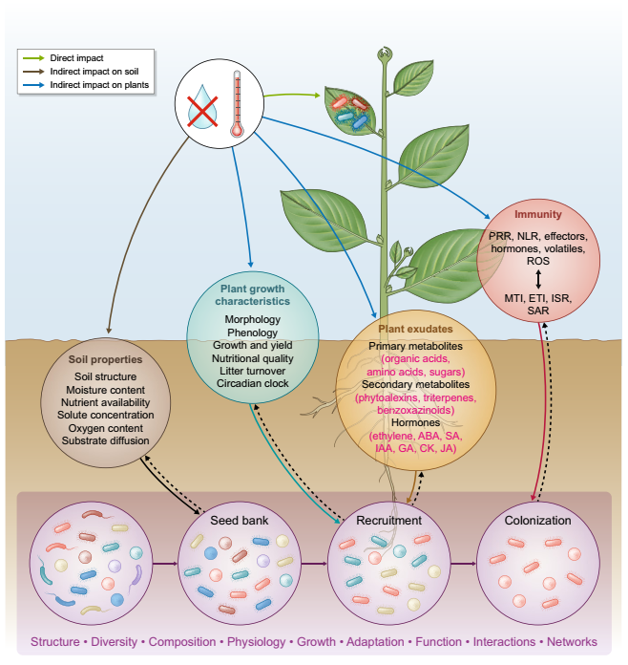


Autotrofné a heterotrofné organizmy – zhody, nezhody alebo náhody?
i. Host–microbiome interactions
4. Can compositional or evolutionary changes in microbiomes help hosts adapt to environmental change within the lifetime of the host?
Climate change can impact the bulk soil ‘seed’ microbiome directly or indirectly via affecting soil properties , As the initial soil microbiome is the source for the plant microbiome assembly, a variation in the composition and functioning of the soil microbiome can determine the outcomes of plant–microbiome interactions under climate change.
As the initial soil microbiome is the source for the plant microbiome assembly, a variation in the composition
and functioning of the soil microbiome can determine the outcomes of plant–microbiome interactions under climate change. Changes in plant growth characteristics and exudation patterns will impact the microbial recruitment process

Slide 17
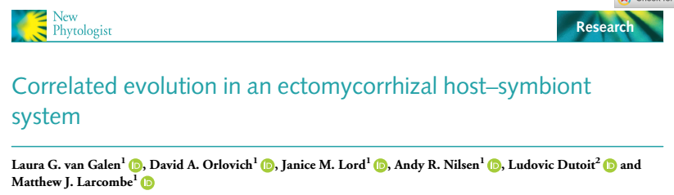
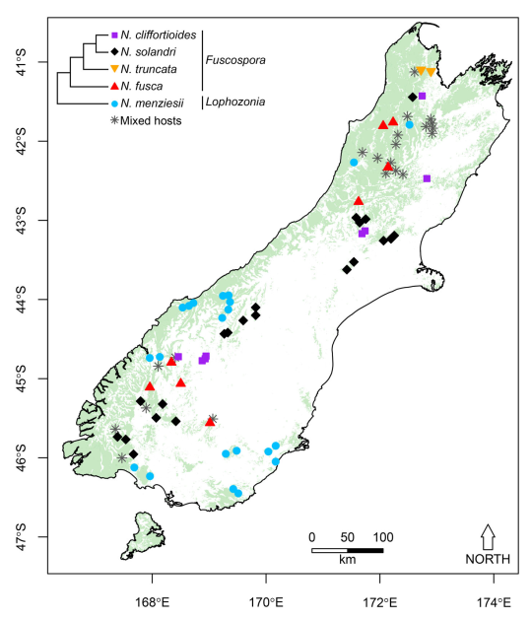
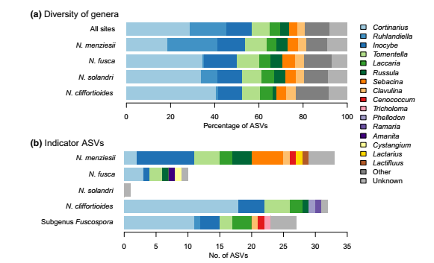
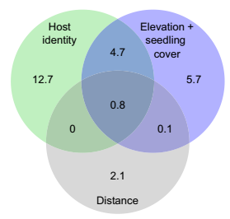
Autotrofné a heterotrofné organizmy – zhody, nezhody alebo náhody?
i. Host–microbiome interactions
5. What is the role of the microbiota in host speciation processes?
Twenty-four per cent of fungal taxa tested
showed affiliations to particular hosts, and tests for cophylogeny revealed significant correlations between host relatedness and the fungal phylogeny

Slide 18

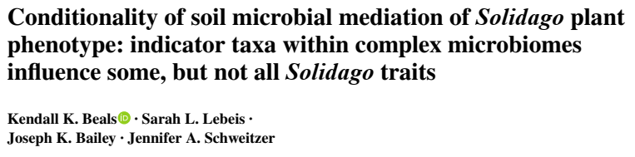
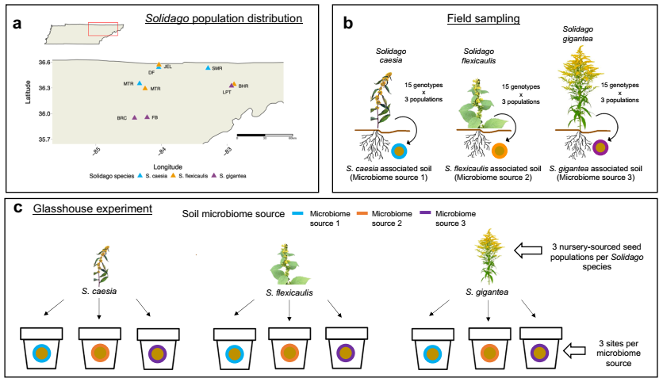
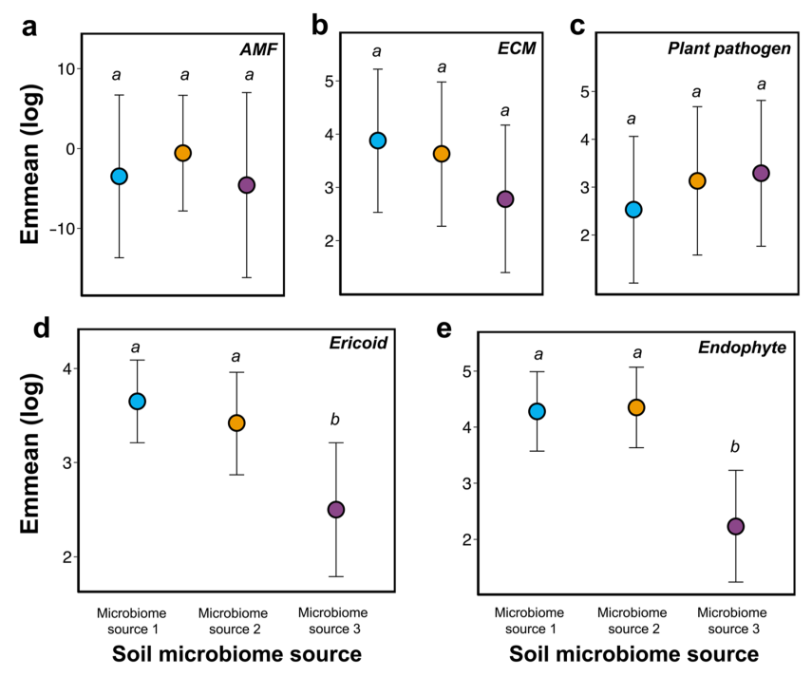
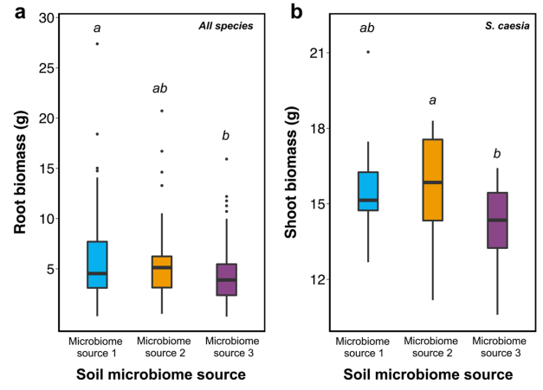
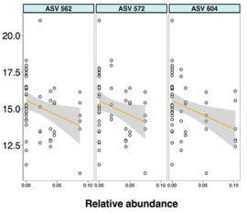
Autotrofné a heterotrofné organizmy – zhody, nezhody alebo náhody?
6. How can the associated microbiota be effectively included in risk assessments of invasive non-native species?
When grown in inoculum from microbiome origin 3, Solidago caesia shoot biomass is negatively correlated with relative
abundance of 20 out of the 29 indicator bacterial and fungal taxa of microbiome source 3

Slide 19
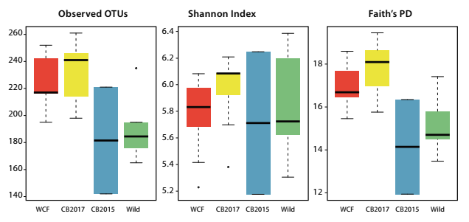
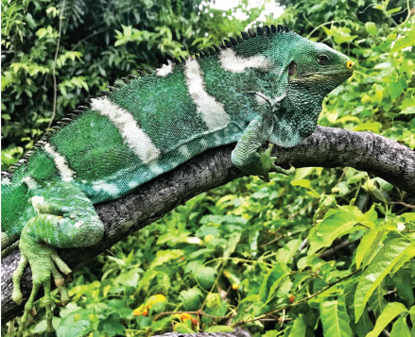
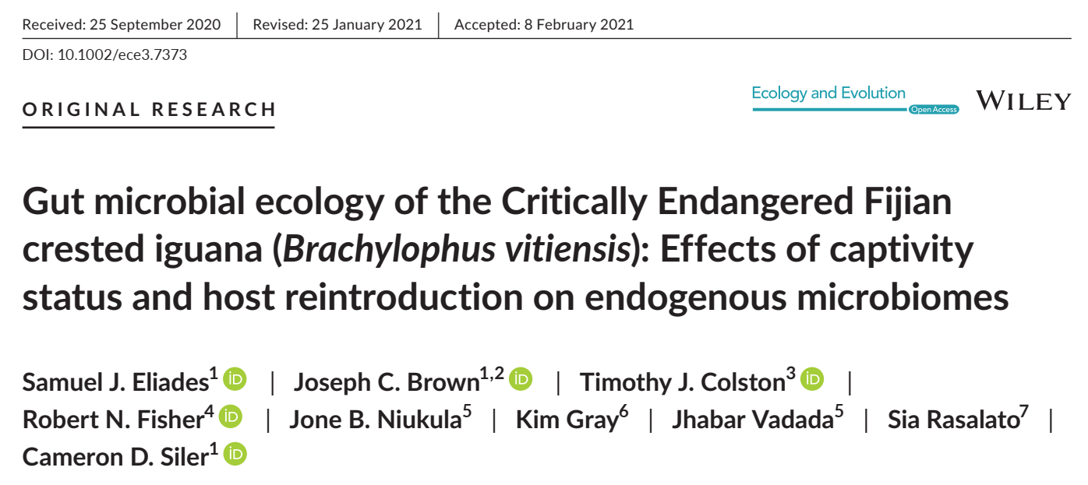
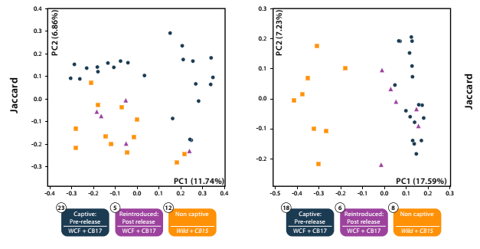
Autotrofné a heterotrofné organizmy – zhody, nezhody alebo náhody?
i. Host–microbiome interactions
7. How does the microbiome of captive animals affect the success of reintroduction programs?
wild-caught founder (WCF) iguanas in captivity, captive-born headstart individuals (CB2017) in captivity, captiveborn individuals released onto Monuriki in 2015 (CB2015), and fully wild individuals on Monuriki Island (Wild).
Samples from cloacal swabs and fecae found significant differentiation in gut microbial community composition and structure between captive and wild iguanas in both sampling schemes.
Approximately two months post release, microbial communities in cloacal samples from formerly captive iguanas closely resembled wild counterparts. Interestingly, microbial communities in fecal samples from these individuals remained significantly distinct from wild conspecifics.

Slide 20
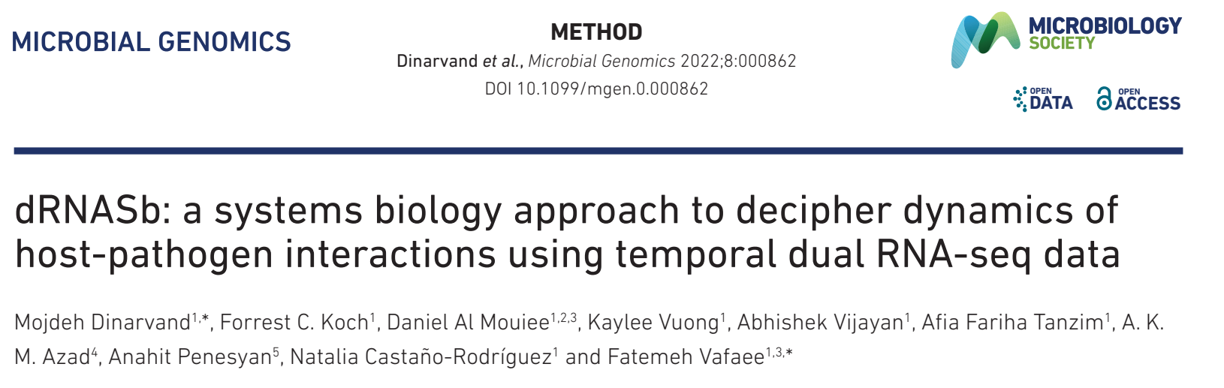
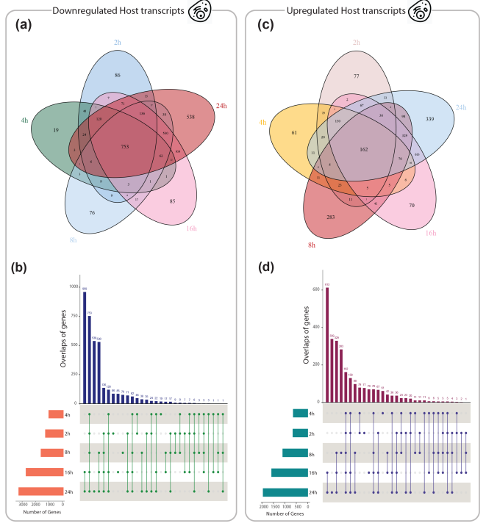
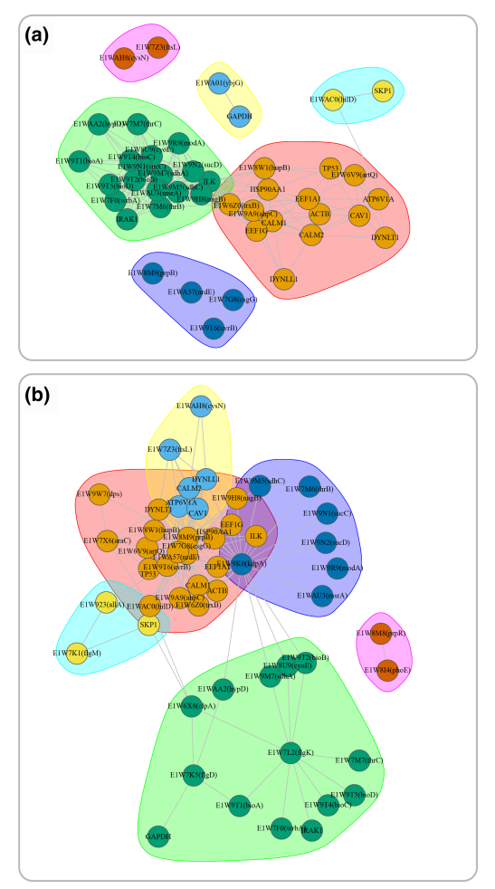
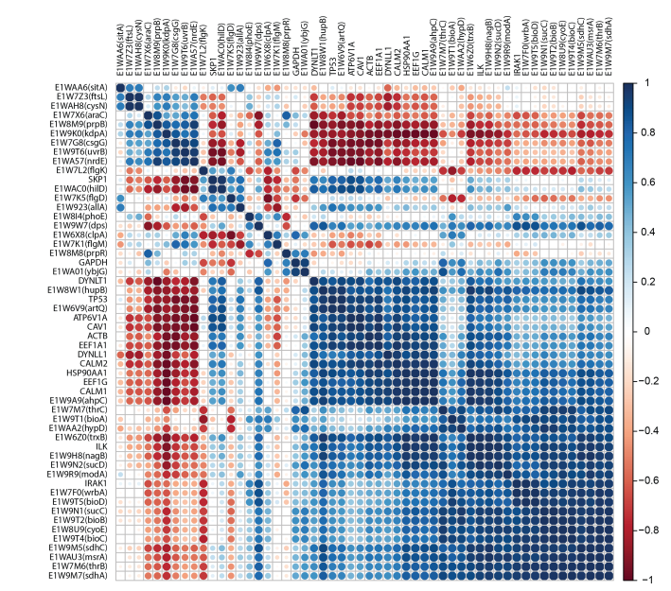
8. How can a ‘systems biology’ approach improve our understanding of host–microbe interactions?
Inter- and Intra-species correlations among pathogen and host genes
Correlation analysis showing hub genes
Visualisations of overlaps among host genes upregulated (3686 genes) or downregulated (2628 genes) across five different time points

Slide 21
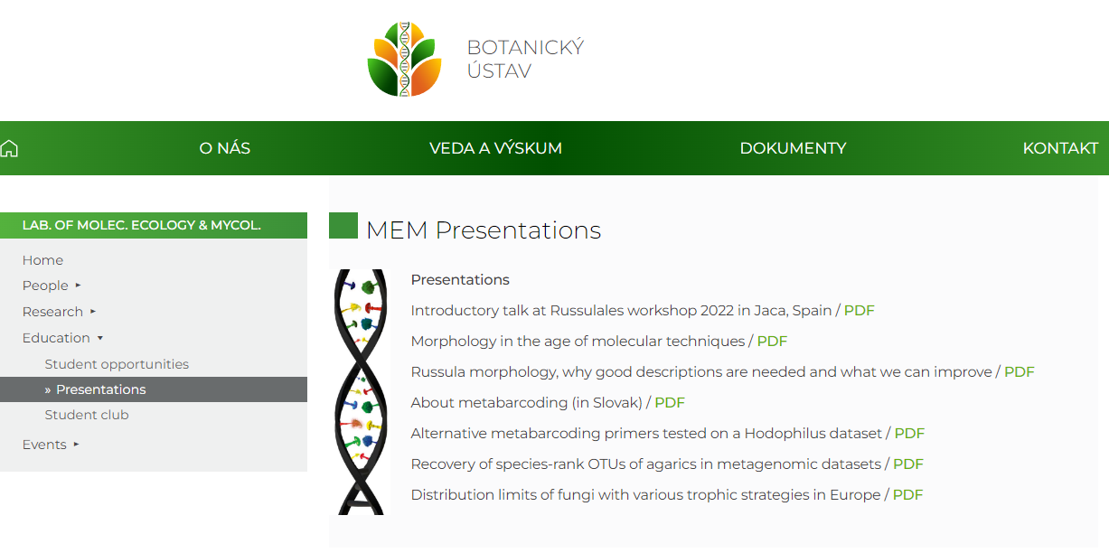
Aktuálne problémy v biológii 2
laboratórium
Molekulárnej
Ekológie a
Mykológie
https://ibot.sav.sk/mem/mem-education/mem-presentations/

